Slide 1
Counting

Slide 2
Introduction
Assume we have a set of objects with certain properties
Counting is used to determine the number of these objects
Examples:
Number of available phone numbers with 7 digits in the local calling area
Number of possible match starters (football, basketball) given the number of team members and their positions

Slide 3
Basic Counting Rules
Counting problems may be hard, and easy solutions are not obvious
Approach:
simplify the solution by decomposing the problem
Two basic decomposition rules:
Product rule
A count decomposes into a sequence of dependent counts (“each element in the first count is associated with all elements of the second count”)
Sum rule
A count decomposes into a set of independent counts
(“elements of counts are alternatives”)

Slide 4
Product Rule
How many ways to assign employees to offices?
1st employee has 10 office choices
2nd employee has 9 office choices
Total office assignment ways: 10x9 = 90

Slide 5
Product Rule
How many different variable names with 2 symbols? First symbol is always alphabet
(e.g. A1, A2, AA)
1st symbol
letter
26 choices
2nd symbol
alphanumeric
26+10 = 36 choices
Total variable name choices: 26x36 = 936

Slide 6
Product Rule Examples
Suppose there are 7 different optional courses in Computer Science and 3 different optional courses in Mathematics. How many choices are there for a student who wants to take one optional course from both the subjects?
(7.3=21)
Suppose a computer installation has four input/output units (A, B,C, and D) and three central processing units (X, Y, and Z). Any input/output unit can be paired with any central processing unit. How many ways are there to pair an input/output unit with a central processing unit?
(4.3=12)

Slide 7
Product Rule Examples
How many different three-letter initials are there that begin with an A?
(1.26.26)
How many different three-letter initials with none of the letters repeated can people have?
(26.25.24)
How many bit strings of length ten both begin and end with a 1?
(1.2⁸.1)

Slide 8
Product Rule
How many different license plates can be made if each plate contains a sequence of three uppercase English letters followed by three digits?
(26³.10³)
How many license plates could begin with AB and have all three letters and digits distinct.
(1.1.26.10³)

Slide 9
Sum Rule
Number of variable names with 1 or 2 length
Variables with 1 length: 26
Variables with 2 length: 936
Total number of variables: 26+936=962

Slide 10
Sum Rule
Suppose that either a member of the mathematics faculty or a student who is a mathematics major is chosen as a representative to a university committee. How many different choices are there for this representative if there are 37 members of the mathematics faculty and 83 mathematics majors and no one is both a faculty member and a student?
(83+37)
A student can choose a computer project from one of three lists. The three lists contain 23, 15, and 19 possible projects, respectively. No project is on more than one list. How many possible projects are there to choose from?
(23+15+19)
Suppose there are 7 different optional courses in Computer Science and 3 different optional courses in Mathematics. How many choices are there for student who can take one optional course?
(7+3)

Slide 11
Sum Rule
How many bit strings are there of length six or less, not counting the empty string?
(2⁶+2⁵+2⁴+2³+2²+2¹)
How many strings are there of lowercase letters of length four or less, not counting the empty string?
(26⁴+26³+26²+26¹)
How many three-digit integers are divisible by 5?
(9.10.1+9.10.1)

Slide 12
Sum Rule
Suppose repetition of digits is permitted.
How many three-digit numbers can be formed from the six digits 2, 3, 4, 5, 7 and 9?
(6.6.6)
How many of these numbers are less than 400?
(2.6.6)
How many are even?
(6.6.1+6.6.1)
How many are multiples of 5?
(6.6.1)

Slide 13
Practice
Practice 6.1
Example: 1-5, 12-14
Exercise: 1-19

Slide 14

Principle of Inclusion Exclusion
An underlying idea behind PIE is that summing the number of elements that satisfy at least one of two categories and subtracting the overlap prevents double counting.

Slide 15
PIE
For instance, the number of people that have at least one cat or at least one dog can be found by taking the number of people who own a cat, adding the number of people that have a dog, then subtracting the number of people who have both.
PIE is particularly useful in problem solving when it is necessary to devise a counting method that ensures an object is not counted twice.

Slide 16
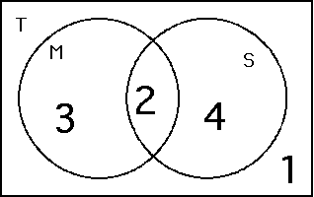
Example 1
Among 10 students, 5 study mathematics, 6 study science, and 2 study both. How many of these students study neither mathematics nor science?

Slide 17
Example 2
How many integers from 1 to 100 are multiples of 2 or 3?
Let A be the set of integers from 1 to 100 that are multiples of 2
A=50
Let B be the set of integers from 1 to 100 that are multiples of 3
B=33
Now, (AnB) is the set of integers from 1 to 100 that are multiples of both 2 and 3, and hence are multiples of 6, implying
(AnB)=16

Slide 18
Permutations
In mathematics, permutation is arranging the members of a set into a sequence or order.
For example, there are six permutations of the set {1,2,3}, namely:
(1,2,3), (1,3,2), (2,1,3), (2,3,1), (3,1,2), and (3,2,1).
These are all the possible orderings of this three-element set.

Slide 19
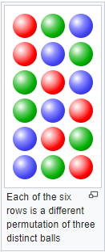
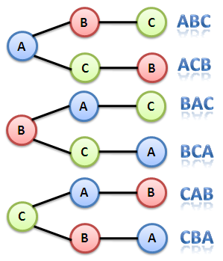
Examples

Slide 20

Introduction to Permutation
All the different ways in which a pair of objects can be selected from five distinguishable objects—such as the letters A, B, C, D, and E. If both the letters selected and the order of selection are considered, then the following 20 outcomes are possible:

Slide 21
Cont…
For combinations, k objects are selected from a set of n objects to produce subsets without ordering. Contrasting the previous permutation example with the corresponding combination, the AB and BA subsets are no longer distinct selections; by eliminating such cases there remain only 10 different possible subsets—AB, AC, AD, AE, BC, BD, BE, CD, CE, and DE.

Slide 22
Cont….
Each of these 20 different possible selections is called a permutation.
In particular, they are called the permutations of five objects taken two at a time, and the number of such permutations possible is denoted by the symbol ₅P₂, read “5 permute 2.”
In general, if there are n objects available from which to select, and permutations (P) are to be formed using k of the objects at a time, the number of different permutations possible is denoted by the symbol _{n}P_{k}.
A formula for its evaluation is
_{n}P_{k} = n!/(n − k)!

Slide 23

Cont…
The expression n!—read “n factorial”—indicates that all the consecutive positive integers from 1 up to and including n are to be multiplied together, and 0! is defined to equal 1. For example, using this formula, the number of permutations of five objects taken two at a time is
(For k = n, _{n}P_{k} = n! Thus, for 5 objects there are 5! = 120 arrangements.)

Slide 24
Cont…
How many ways can five of the letters of the word ALGORITHM be selected and written in a row?
(9P5 or 9.8.7.6.5)
How many ways can five of the letters of the word ALGORITHM be selected and written in a row if the first two letters must be TH?
(7P3 or 7.6.5)
Find the number of ways that a party of seven persons can arrange themselves in a row of seven chairs.
(7P7 or 7!)

Slide 25
Cont…
A debating team consists of three boys and two girls. Find the number n of ways they can sit in a row if the boys and girls are each to sit together.
(3!.2!+2!.3! )
How many ways are there to select a first-prize winner, a second-prize winner, and a third-prize winner from 100 different people who have entered a contest?
(100P3 or 100.99.98)
Find the number n of ways that five large books, four medium sized book, and three small books can be placed on a shelf so that all books of the same size are together.
(5!.4!.3!.3! )

Slide 26
Cont…
Suppose that there are eight runners in a race. The winner receives a gold medal, the second place finisher receives a silver medal, and the third-place finisher receives a bronze medal. How many different ways are there to award these medals, if all possible outcomes of the race can occur and there are no ties?
(8P3 or 8.7.6)

Slide 27
Combination
In mathematics, a combination is a selection of items from a collection, such that (unlike permutations) the order of selection does not matter.
For example, given three fruits, say an apple, an orange and a pear, there are three combinations of two that can be drawn from this set:
an apple and a pear; an apple and an orange; or a pear and an orange.
But 6 permutations are possible i.e. (apple, pear) (pear, apple); (apple, orange) (orange, apple); and (pear, orange) (orange, pear)

Slide 28


Cont…
Combinations refer to the combination of n things taken k at a time with or without repetition.
If, in the previous example, it were possible to have two of any one kind of fruit there would be 3 more 2-selections:
one with two apples, one with two oranges, and one with two pears.
Formula for non repetitive combinations

Slide 29
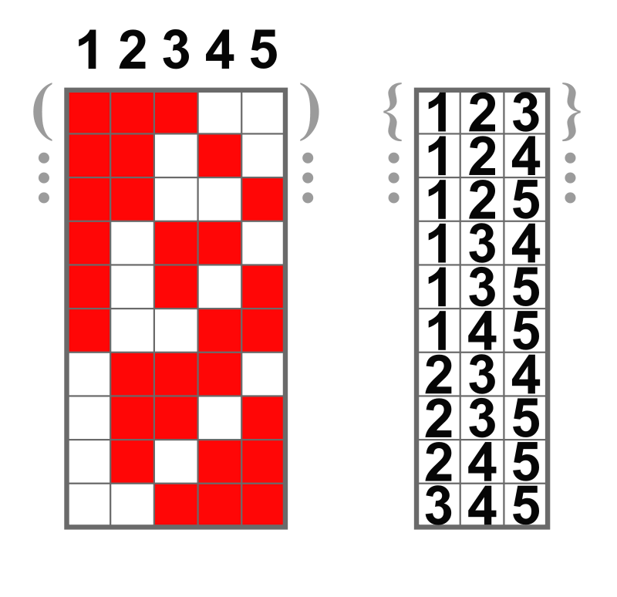
Example 3-element subsets of a 5-element set

Slide 30
Examples
Let X = {a, b, c, d, e}. List all 3-combinations of the 5 elements of the set X.
A student is to answer eight out of ten questions on an exam.
- Find the number m of ways that the student can choose the eight questions
C(10,8)
- Find the number m of ways that the student can choose the eight questions, if the first three questions are compulsory.
(C(7,5))
How many unordered selections of two elements can be made from the set {0, 1, 2, 3}?
C(4,2)
Suppose five members of a group of twelve are to be chosen to work as a team on a special project. How many distinct five-person teams can be selected?
(C(12,5)

Slide 31
Cont…
A computer programming team has 14 members.
- How many ways can a group of seven be chosen to work on a project?
Suppose eight team members are women and six are men
- How many groups of seven can be chosen that contain four women and three men
- How many groups of seven can be chosen that contain at most three women?
- Suppose two team members refuse to work together on projects. How many groups of seven can be chosen to work on a project?
- Suppose two team members insist on either working together or not at all on projects. How many groups of seven can be chosen to work on a project?
Notes:
C(14,7)
C(8,4)C(6,3)
C(14,7)-C(8,7)
C(8,1) ⋅ C(6,6)+C(8,2) ⋅ C(6,5)+C(8,3) ⋅ C(6,4)
C(12,7) + C(12,6) + C(12, 6)
C(12, 7) + C(12, 5)

Slide 32
Binomial Theorem

Slide 33
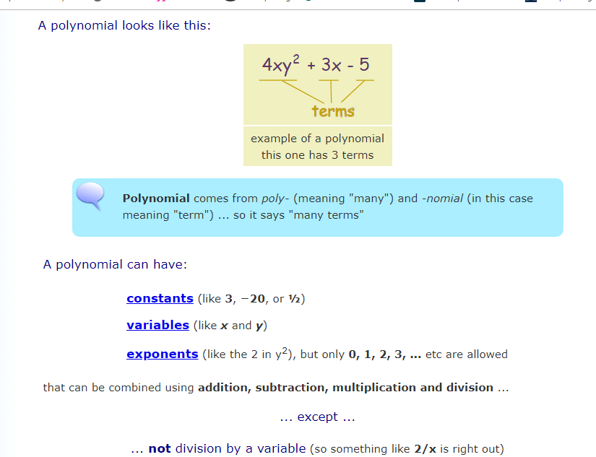
Polynomial

Slide 34
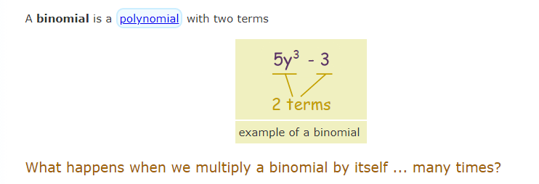
Binomial

Slide 35
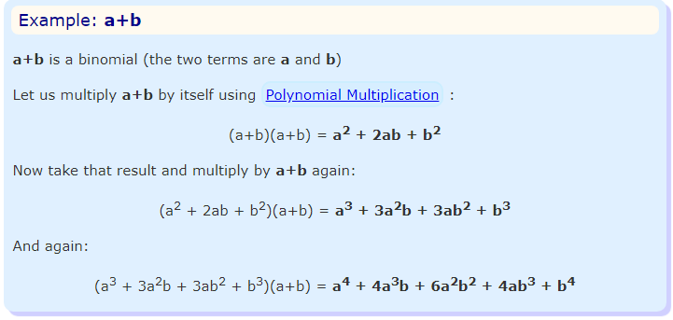
Cont…

Slide 36
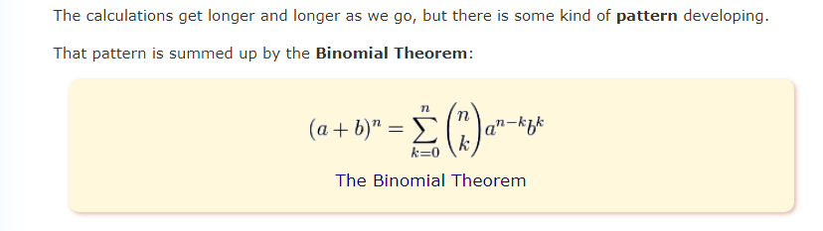
Cont….

Slide 37
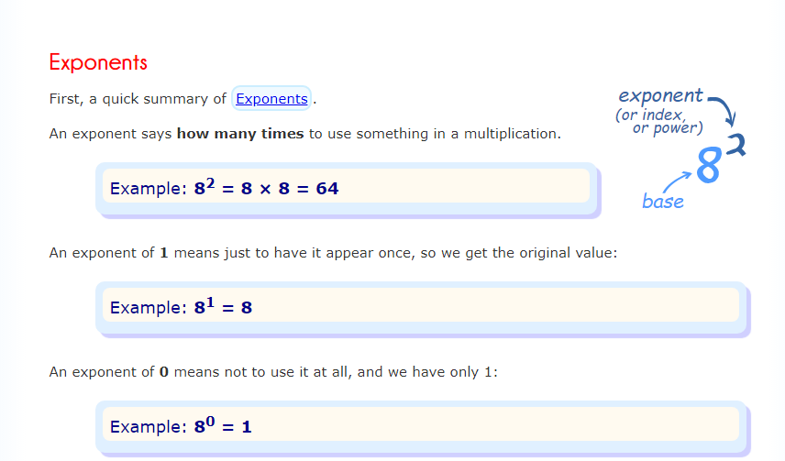
Binomial Theorem

Slide 38
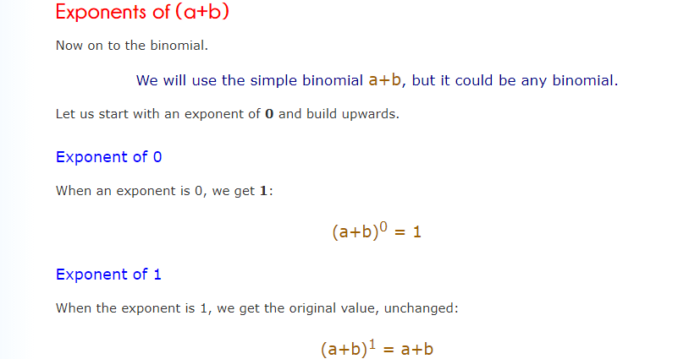
Cont…

Slide 39
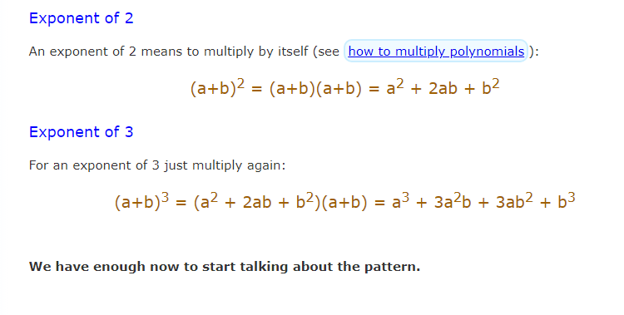
Cont…

Slide 40
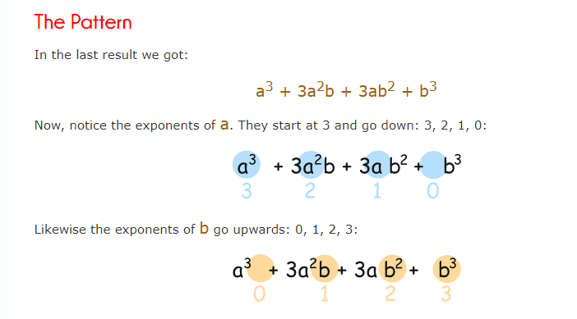
Cont…

Slide 41
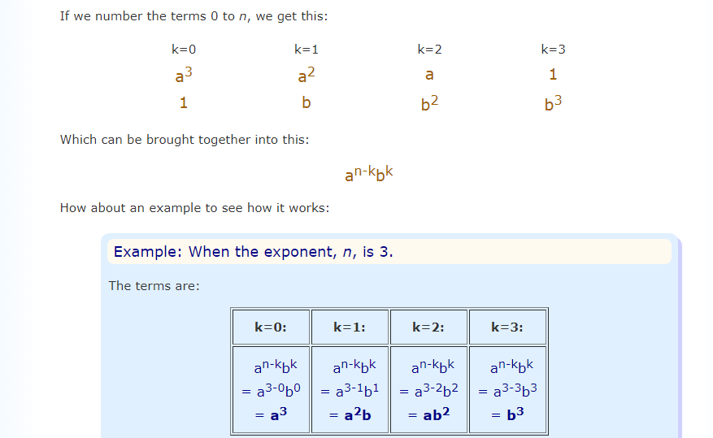
Cont…

Slide 42
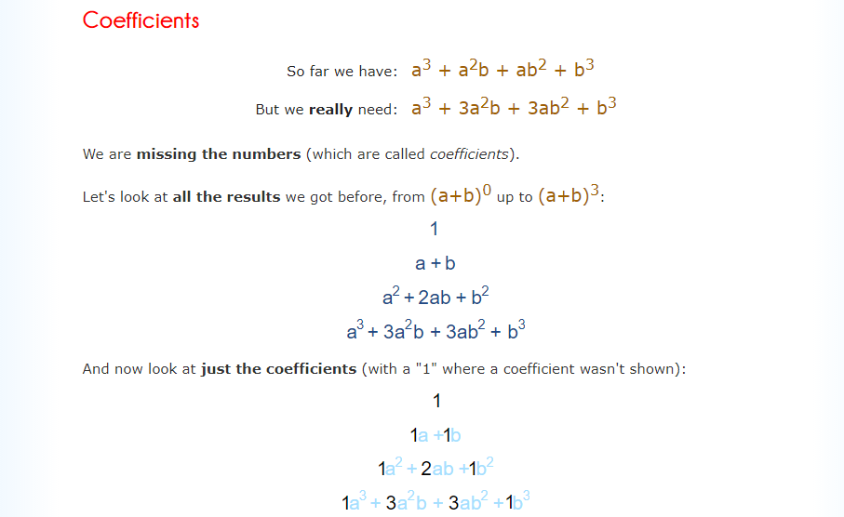
Cont…

Slide 43
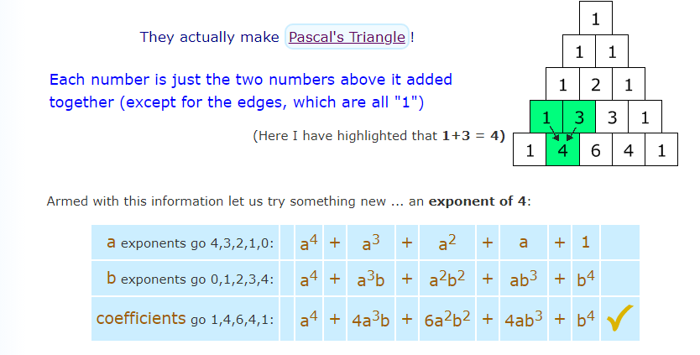
Cont…

Slide 44

Cont…
Solve (a$+{b)}^{5}$

Slide 45
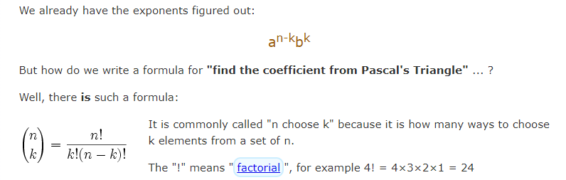
Cont…

Slide 46
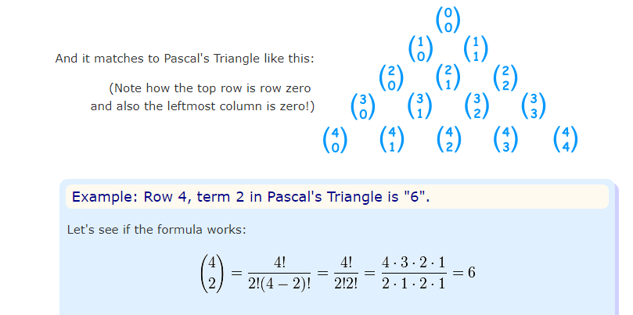
Cont…

Slide 47
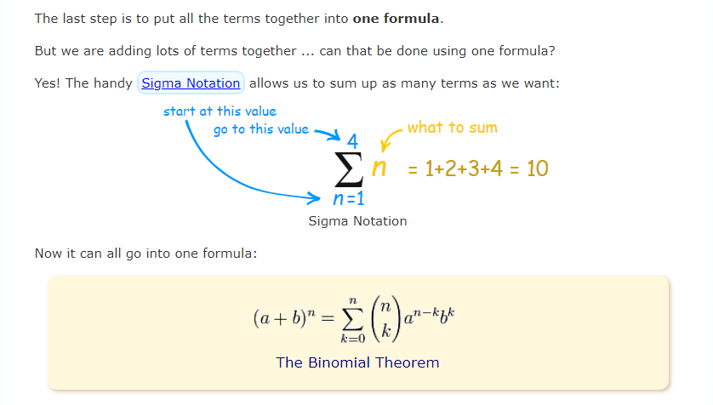
Binomial Theorem

Slide 48
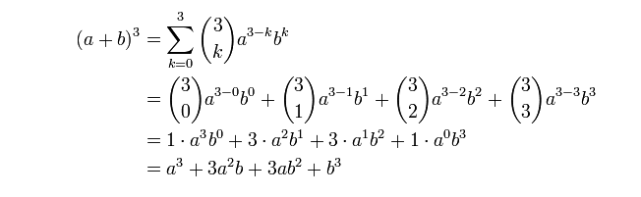
Example

Slide 49
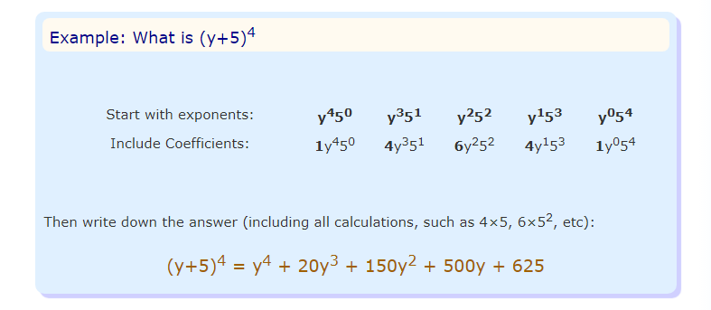
Cont…

